Slide 1

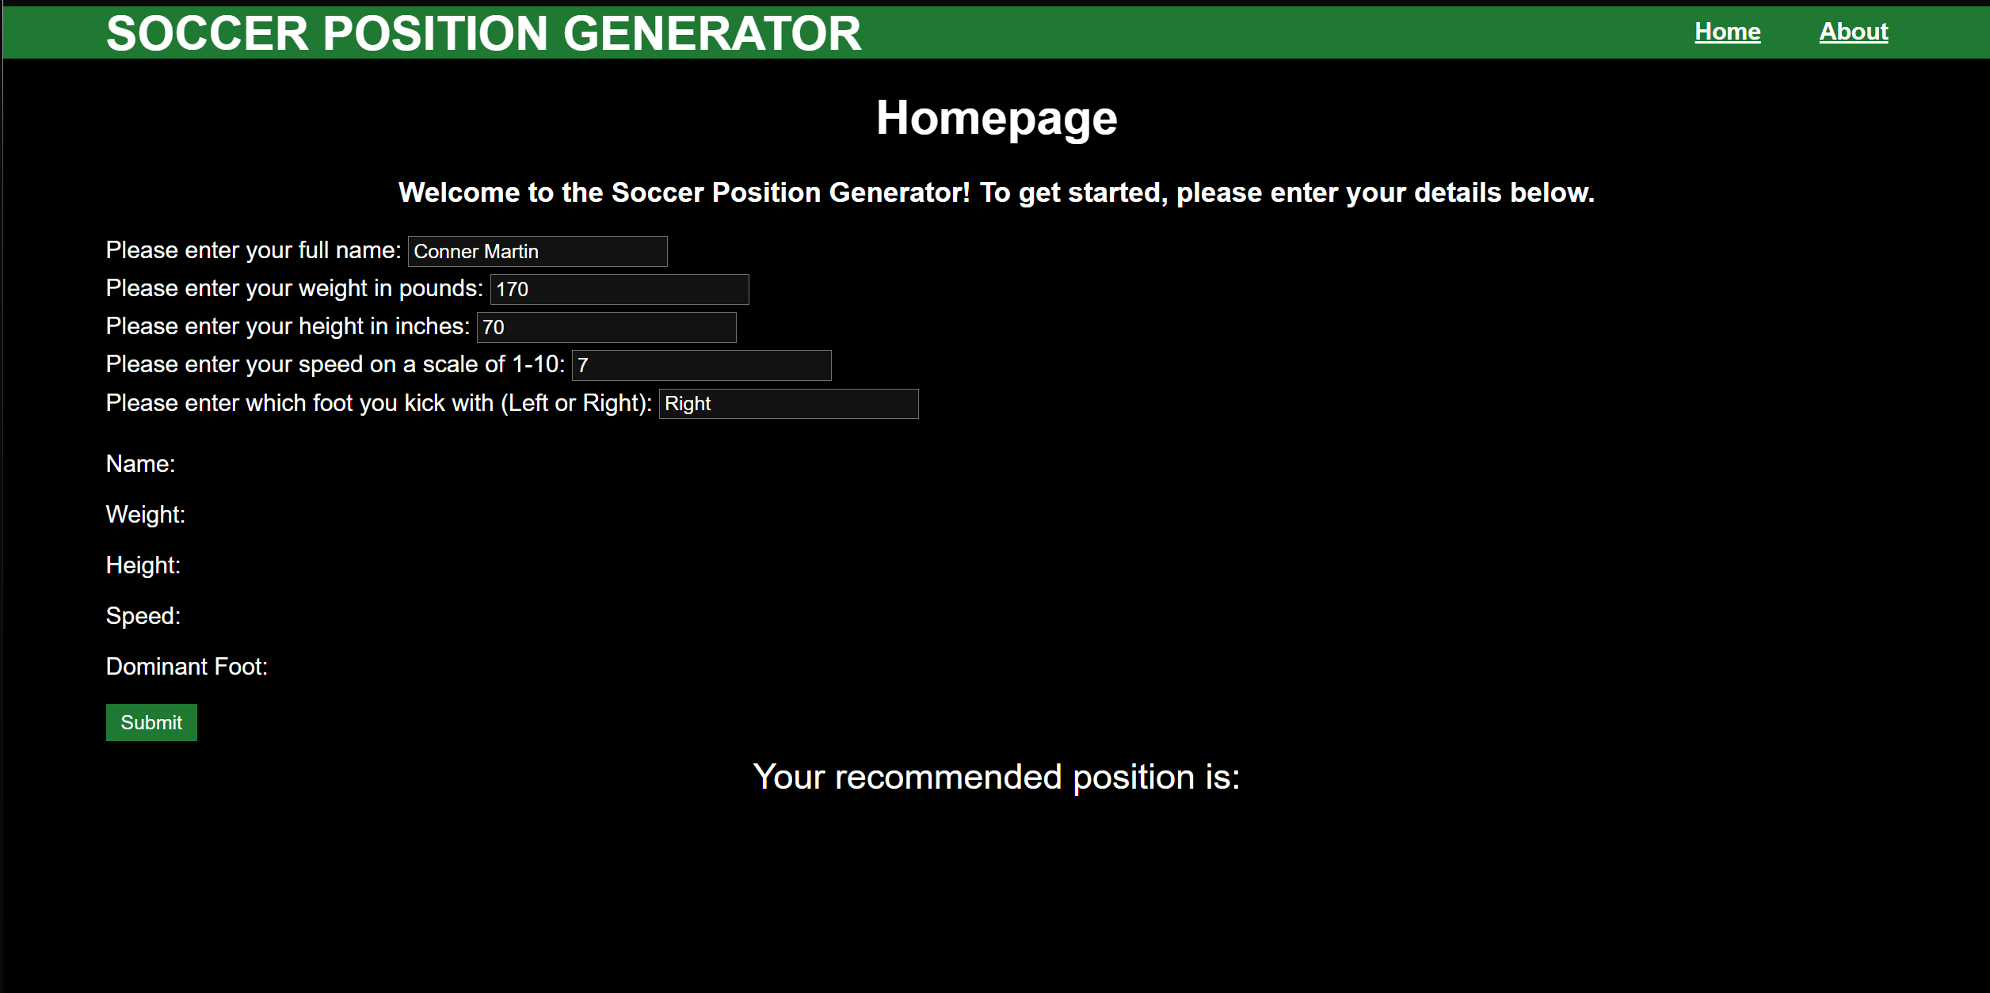
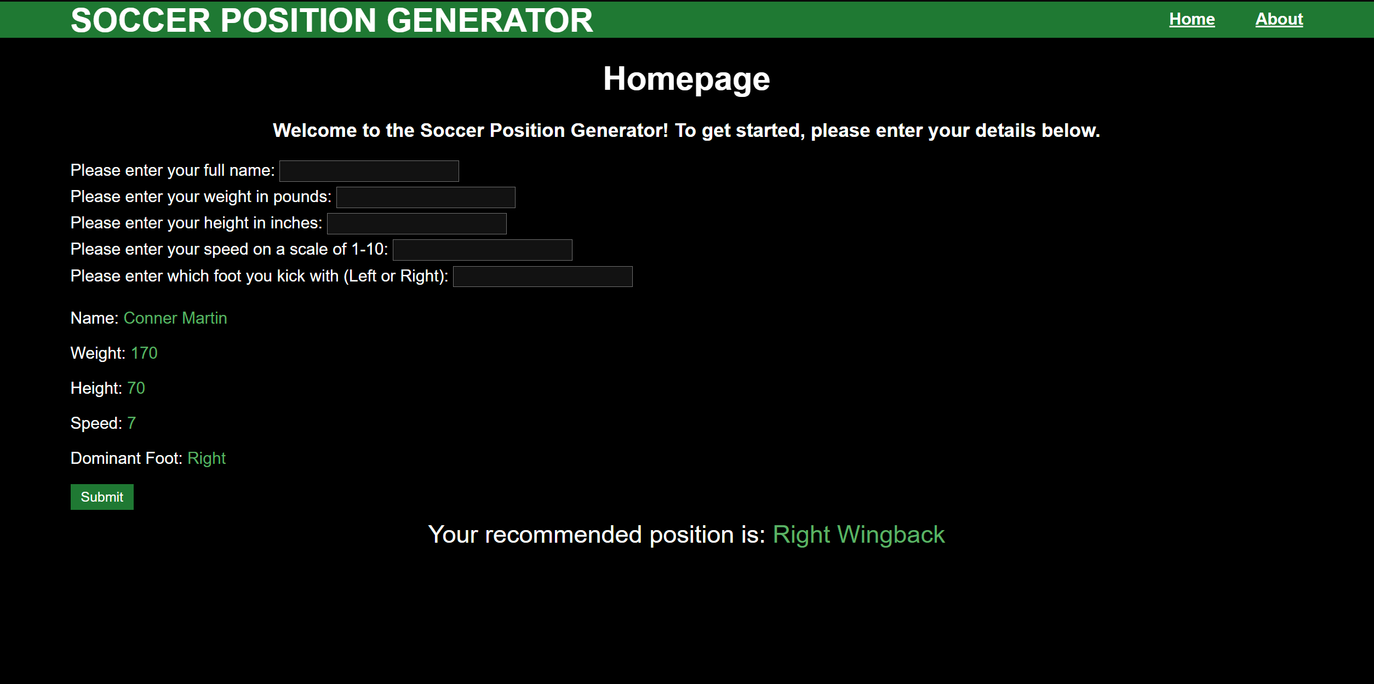
Soccer Position Generator By: Conner Martin
This generator will give you a position to play on a soccer field based on user variables such as height, weight, speed, and dominant foot.
Here is the website with user details before submitting
Here is the website with the recommended position based on the user details, different details result in different positions

